Slide 1


Crash Course on GIT
Carlos Diego N Damasceno - https://github.com/damascenodiego/

Slide 2


Crash Course on GIT
Scott Chacon and Ben Straub. 2014. Pro Git (2nd ed.). Apress, Berkely, CA, USA.
Eric Sink. 2011. Version Control by Example (1st ed.). PYOW Sports Marketing.

Slide 3




Agenda
Version Control
Version Control Systems (VCS)
Types of VCS
Crash Course on Git
git history
Basic concepts
Installing git
Getting started
GitHub 101
Eclipse Git
References++

Slide 4


Slide 5
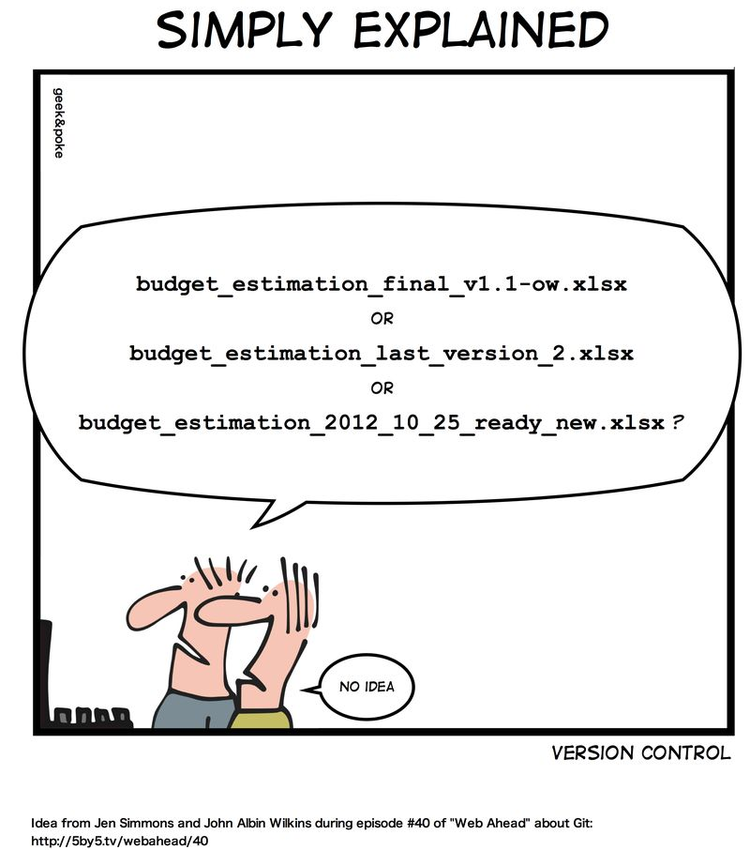
Version Control Systems (Concepts)

Slide 6
Version Control
Software Configuration Management (SCM)
Umbrella activity [Pressman, 2010]
“The art of identifying, organizing, and controlling modifications to software being developed”
Maximize productivity by minimizing mistakes → Confusion!!!
Tasks
Identification
Version control
Change Control
Configuration auditing
Reporting
Pressman, R. S. Software engineering: A practitioner’s approach. 5th ed. McGraw-Hill Higher Education, 2001.

Slide 7

Version Control
“The task of keeping a software system consisting of many versions and configurations well organized”
[Kemper & Oxley, 2012]
Kemper C., Oxley, I. 2012. Foundation Version Control for Web Developers. Appress.

Slide 8


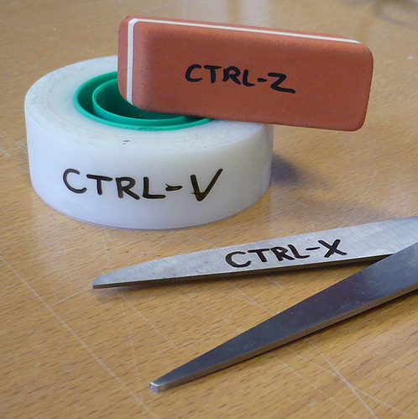

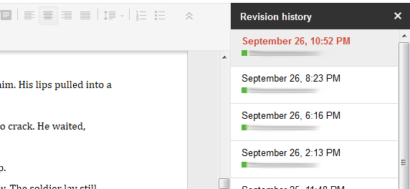
Version Control

Slide 9
Version Control System
“A piece of software that helps the developers on a software team work together and also archives a complete history of their work.”
[Sink, 2011]
Eric Sink. 2011. Version Control by Example (1st ed.). PYOW Sports Marketing.

Slide 10

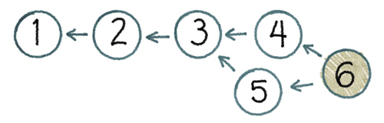
Version Control System
Three basic goals of a Version Control System (VCS) [Sink, 2011]
People must be able to work simultaneously, not serially.
No conflicting changes
Keep every version of everything that has ever existed
Eric Sink. 2011. Version Control by Example (1st ed.). PYOW Sports Marketing.

Slide 11
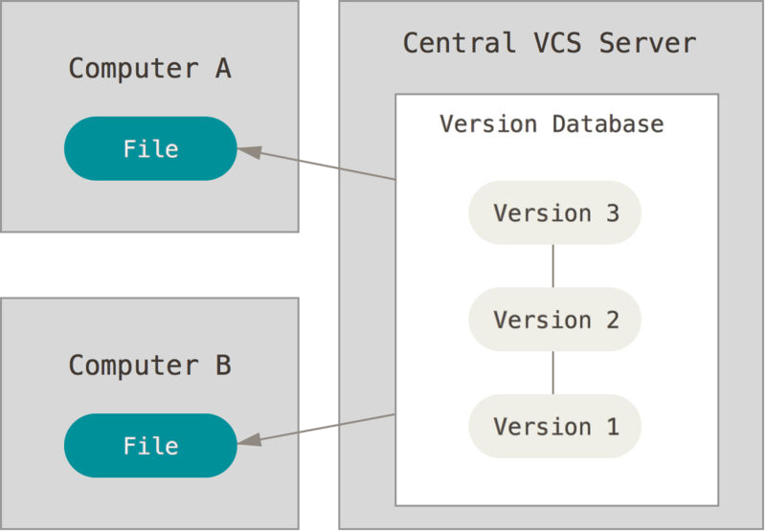
Types of Version Control Systems
Centralized VCS (CVCS)
Central Server
Collaborative work
Single point of failure
Examples
Concurrent Version System (CVS)
http://www.nongnu.org/cvs
Apache Subversion (SVN)
https://subversion.apache.org
Most popular CVCS
Centralized version control [Chacon & Straub, 2014]
Scott Chacon and Ben Straub. 2014. Pro Git (2nd ed.). Apress, Berkely, CA, USA.

Slide 12
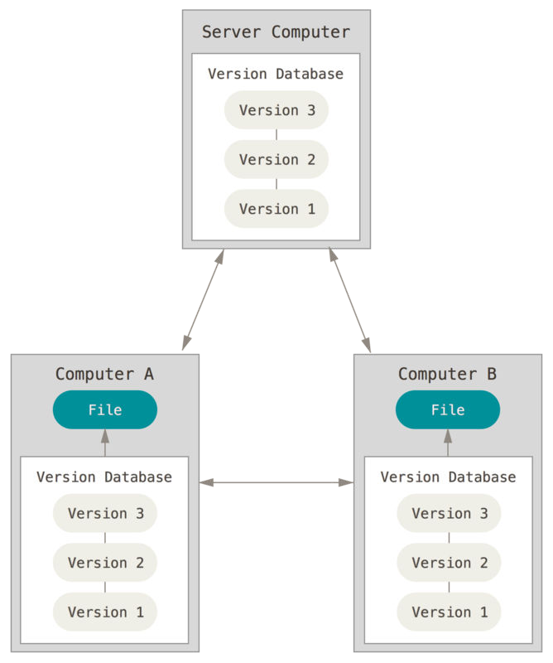
Types of Version Control Systems
Distributed VCS (DVCS)
Remote Server
Collaborative work
Several remote servers
Full backup
Examples
Mercurial (hg)
http://mercurial.selenic.com/
git
http://git-scm.com/
https://github.com/
Distributed version control [Chacon & Straub, 2014]
Scott Chacon and Ben Straub. 2014. Pro Git (2nd ed.). Apress, Berkely, CA, USA.

Slide 13


Slide 14



Crash Course (git history)
Linux kernel
Linus Torvalds
Open source software project of fairly large scope
1991–2002: Changes passed around as patches/archived files
2002: Proprietary DVCS → BitKeeper
2005: Linux community and the BitKeeper company relationship broke down
Free-of-charge status was revoked

Slide 15


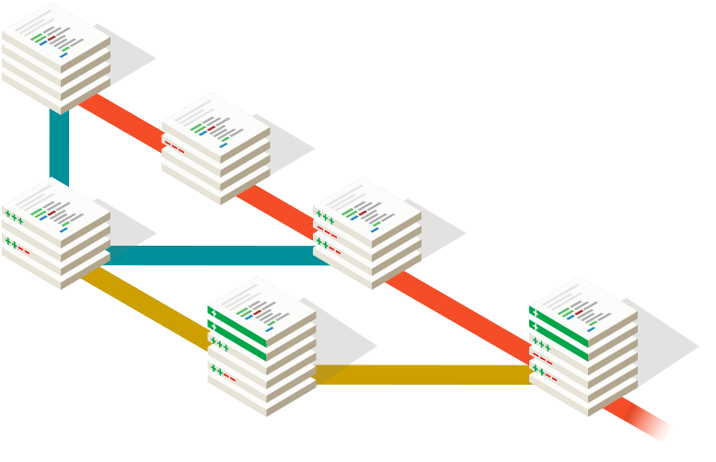

Crash Course (git history)
VCS requirements
Speed
Simple design
Strong support for non-linear development
Thousands of parallel branches
Fully distributed
Able to handle large projects efficiently
e.g. Linux kernel

Slide 16

Crash Course (git history)

Slide 17
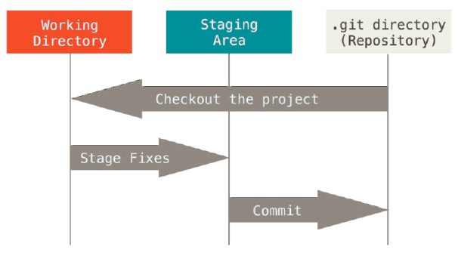

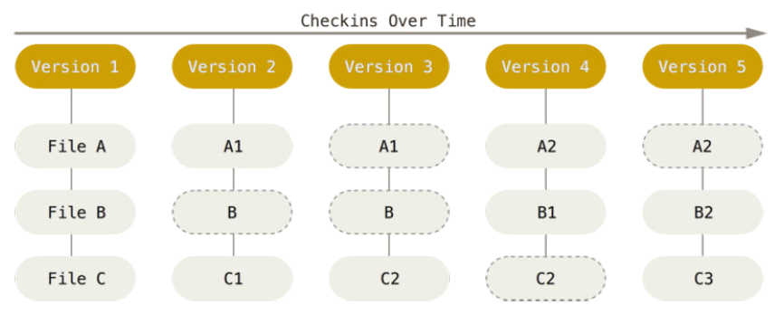
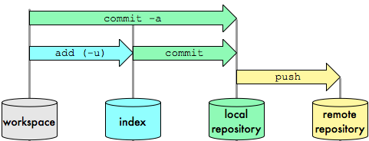
Crash Course (Basic concepts)
Basic concepts
Snapshots
Integrity
Generally only adds data
The three states
Storing data as snapshots of the project over time.
24b9da6552252987aa493b52f8696cd6d3b00373
The three stages: Working directory, staging area, and Git directory.

Slide 18





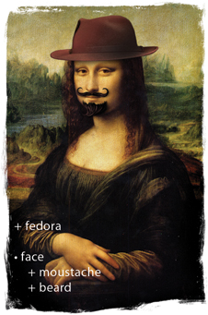

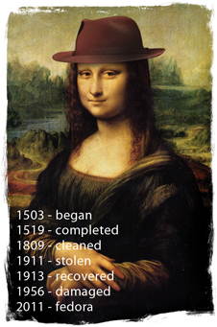
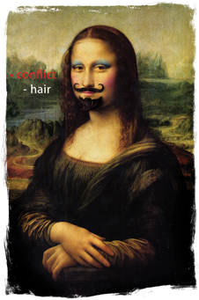
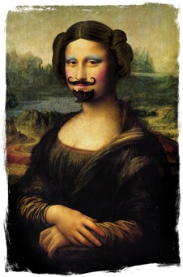

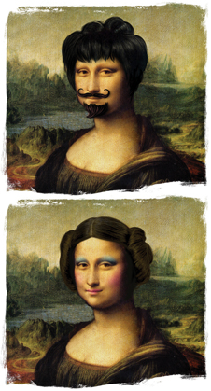
Crash Course (Basic concepts)
Basic operations
Add
Edit
Delete
Rename
Status
Diff
Revert
Log
Tag
Branch
Merge
Resolve
Eric Sink. 2011. Version Control by Example (1st ed.). PYOW Sports Marketing.

Slide 19

Crash Course (Installing git)
Windows - http://git-scm.com/download
Linux - Package management tool
# ~ apt-get install git

Slide 20
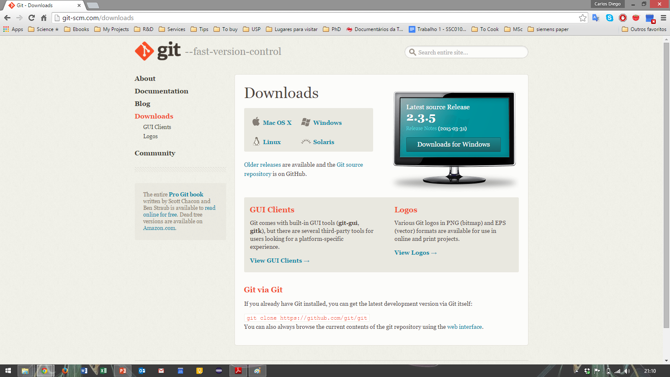

Crash Course (Installing git)

Slide 21
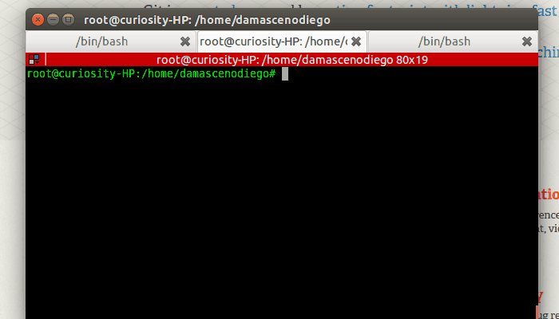

Slide 22
Crash Course on GIT
Getting Started

Slide 23
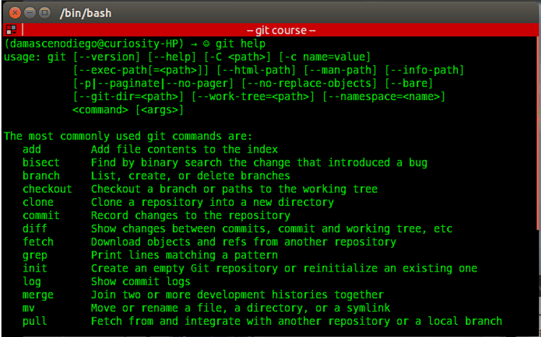
Crash Course (Getting Started)
git help
git help <parameter>
git help
It shows the git manual.
Notes:
It shows the git manual.

Slide 24
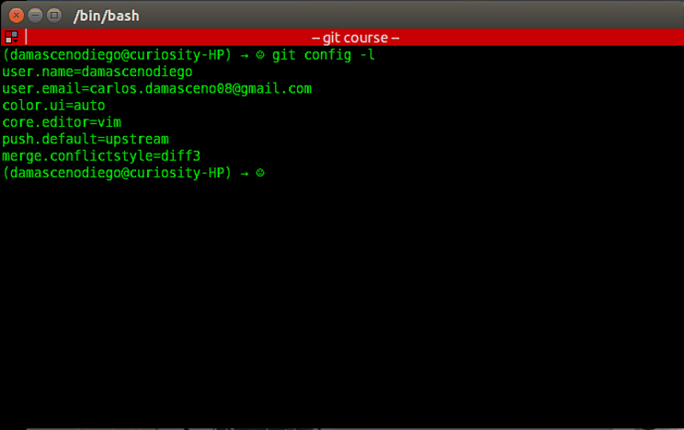
Crash Course (Getting Started)
git config -l
git config --global <variable> <parameter>
git config
This command allows to check and edit the settings of a specific project. E.g. username (user.name) and email (user.email).
Notes:
check and edit the settings of a specific project.
User.name
User.email

Slide 25
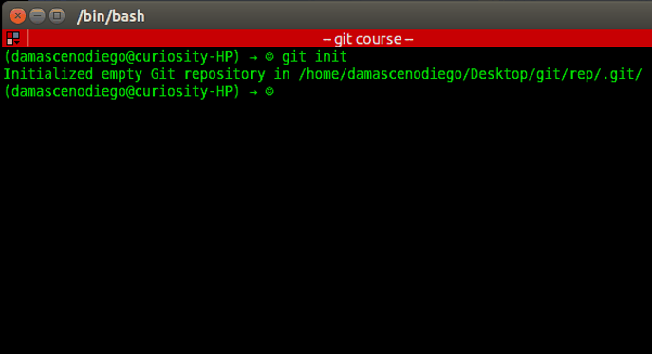
Crash Course (Getting Started)
git init
git init
This command allows to setup a git repository. It creates the .git directory – a Git repository skeleton.
At this point nothing is tracked!
Notes:
setup a git repository
.git

Slide 26
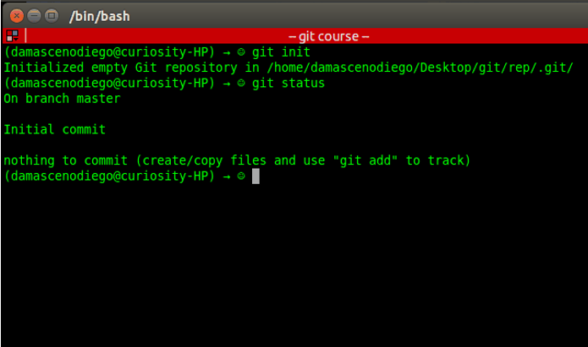
Crash Course (Getting Started)
git status
git status
This command shows differences between working directory, staging area and last commit in the repository.
Notes:
shows differences between working directory, staging area and last commit

Slide 27
Crash Course (Getting Started)
The three stages: Working directory, staging area, and Git directory.
Notes:
working directory: where your files are located. You edit here
staging area: you keep/organize files before commit
commit
.git dir: files are versioned
Checkout: grab files from rep

Slide 28
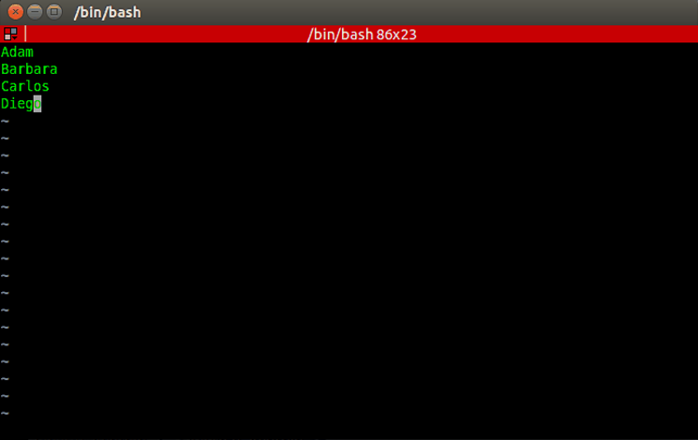
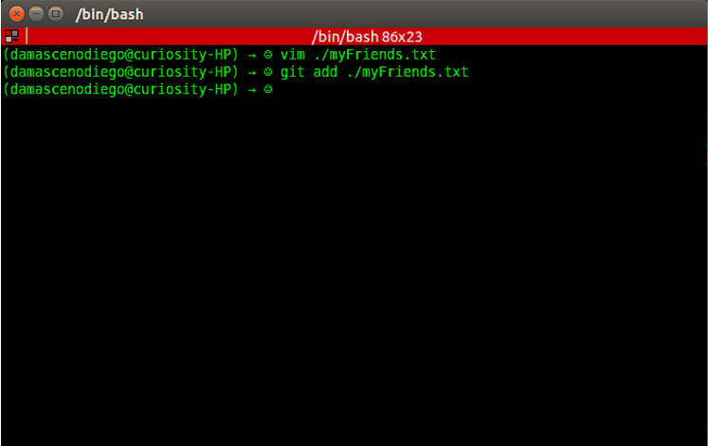
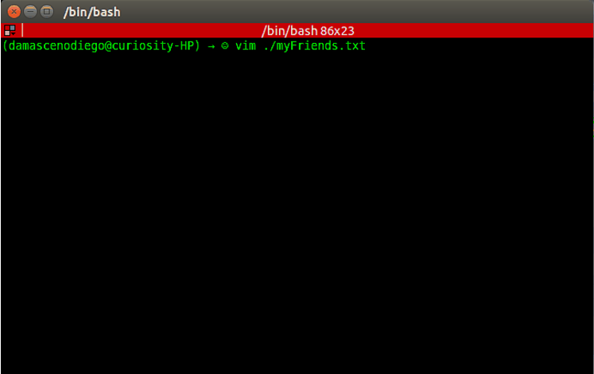
Crash Course (Getting Started)
git add <filenames>
git add
This command updates the index (staging area) using the current content found in the working tree (working directory), to prepare the content staged for the next commit.
Adam
Barbara
Carlos
Diego
Create a list with 4 names of friends (myFriends.txt)
Notes:
Add files to the index/staging area
Create a list of friends to a party

Slide 29
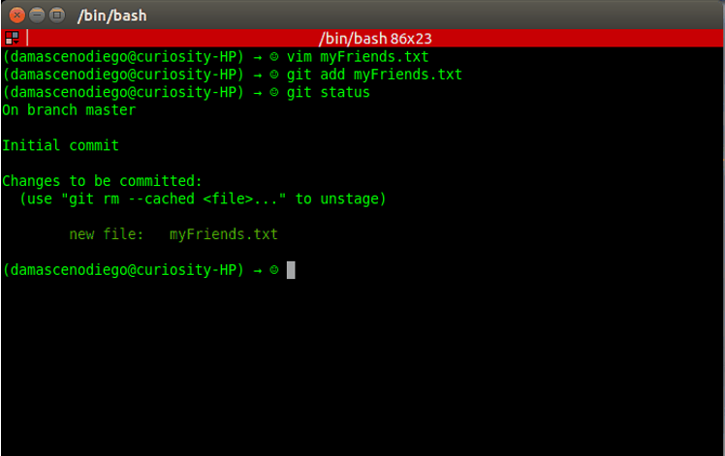
Crash Course (Getting Started)
git status

Slide 30
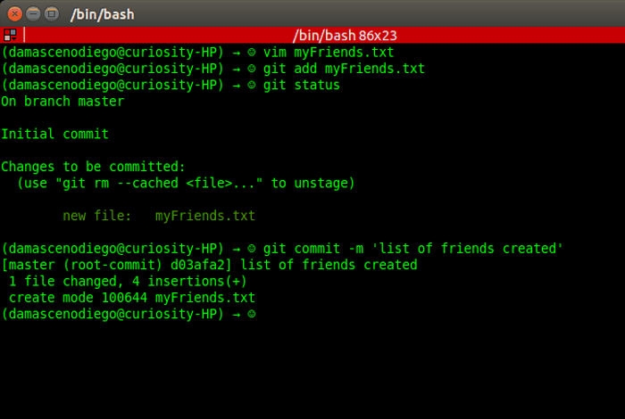
Crash Course (Getting Started)
git commit –m ‘<message>’
git commit
Stores the current contents of the index (staging area) in a new commit along with a log message from the user describing the changes.
‘list of friends created’
Notes:
Send the files to the rep with a log message

Slide 31
Crash Course (Getting Started)
unversioned
git commit
git init

Slide 32
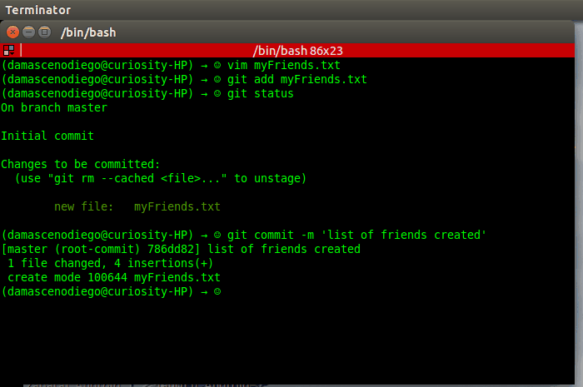
Crash Course (Getting Started)
git status

Slide 33
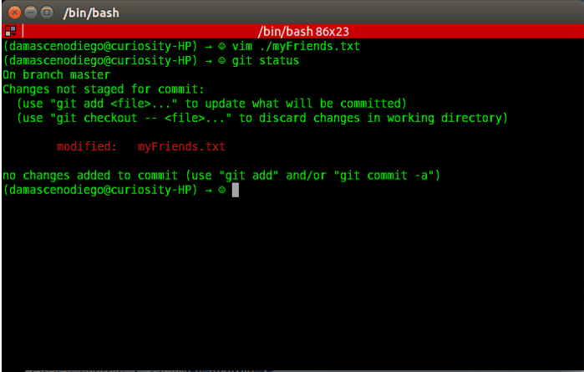
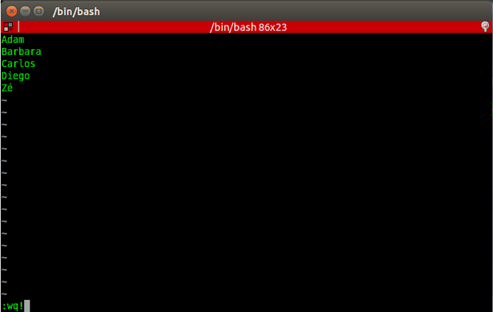
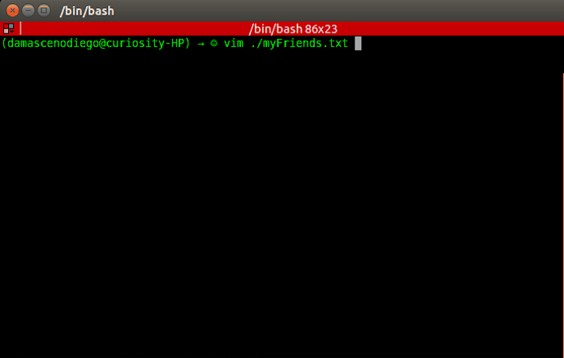
Crash Course (Getting Started)
Add another friend name (Zé)
at the end of myFriends.txt and run
git status

Slide 34
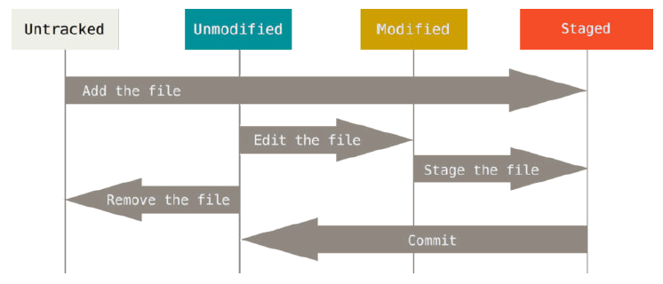
Crash Course (Getting Started)
The lifecycle of the status of your files.

Slide 35
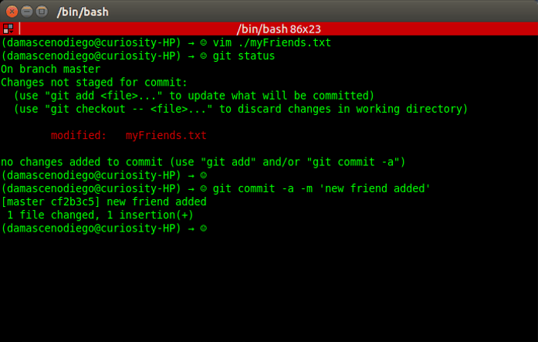
Crash Course (Getting Started)
git commit –a –m ‘<message>’
‘new friend added’

Slide 36
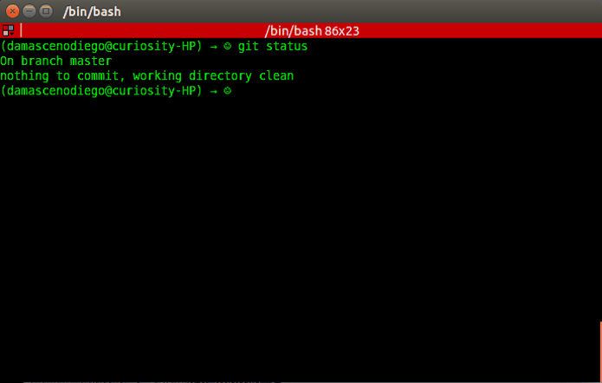
Crash Course (Getting Started)
git status

Slide 37
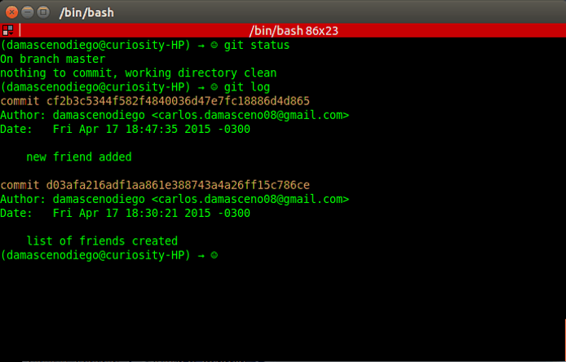

Crash Course (Getting Started)
git log
git log
Shows the commit logs.

Slide 38
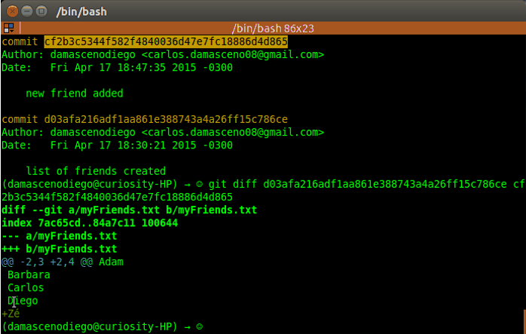
Crash Course (Getting Started)
git diff <hash0> <hash1>
git diff
Show changes between two commits.

Slide 39
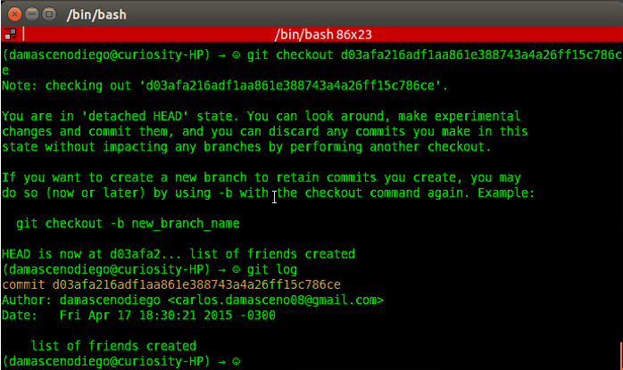
Crash Course (Getting Started)
git checkout <hash>
git checkout
Updates files in the working tree to match the version in the index or the specified tree.

Slide 40
Crash Course (Getting Started)
git checkout <hash>

Slide 41
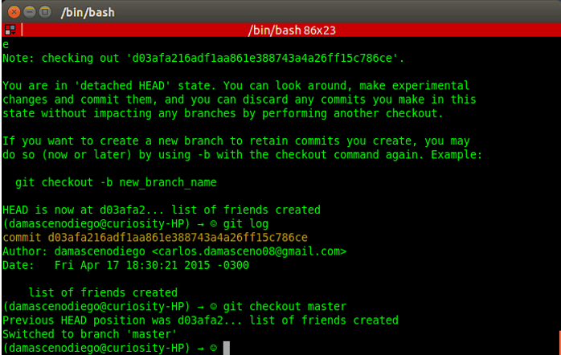
Crash Course (Getting Started)
git checkout master

Slide 42
Crash Course (Getting Started)
git checkout master

Slide 43
Crash Course (Getting Started)
<otherList>
Brian
Rafael
<master>
Adam
Barbara
Carlos
Diego
Zé

Slide 44
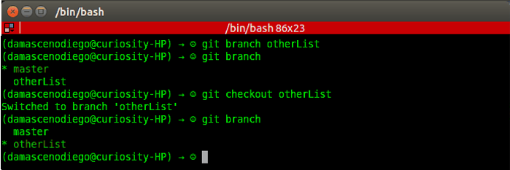
Crash Course (Getting Started)
git branch <branch name>
git branch
git checkout <branch name>
git branch
The command creates a new branch head named <branch name>.
With no arguments, branches are listed; the current branch will be highlighted with an asterisk.
otherList
Notes:
Cria um branch (ramo) denominado com o nome passado como parametron
Ele so cria
Sem parametron lista
Para mudar para ele dar checkout

Slide 45
Crash Course (Getting Started)
git branch <branch name>
git checkout <branch name>

Slide 46
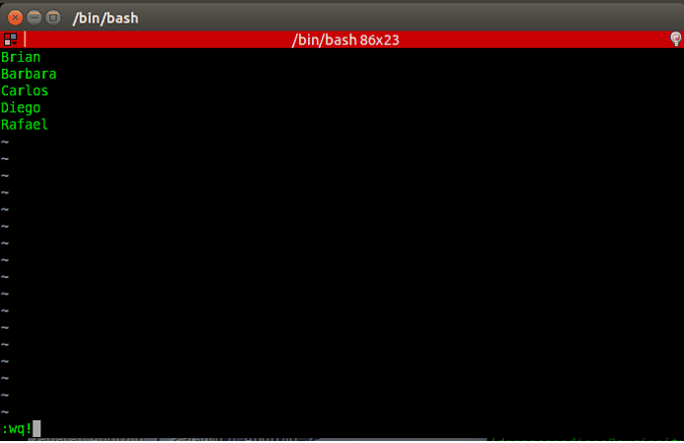
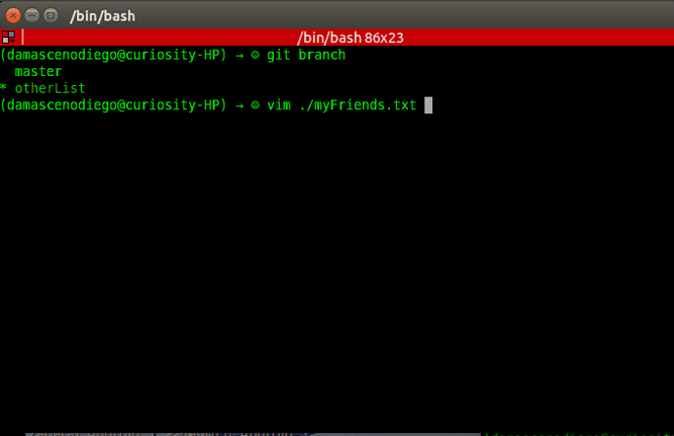
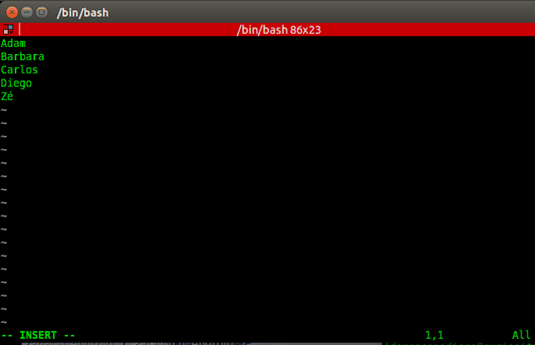
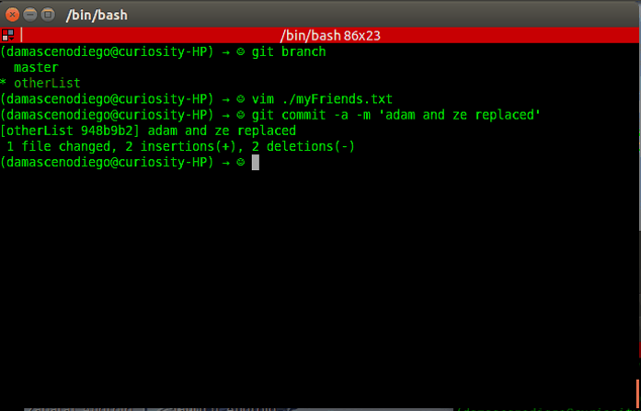
Crash Course (Getting Started)
Replace some names (Adam and Zé)
by other names (Brian and Rafael)
and run
git commit -a -m <message>
git commit –a –m ‘adam and ze replaced'

Slide 47
Crash Course (Getting Started)
git commit -a -m <message>

Slide 48
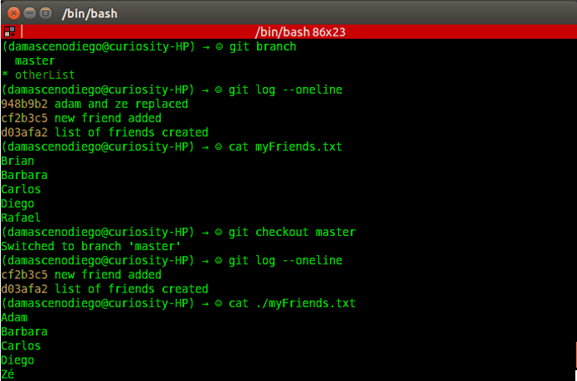
Crash Course (Getting Started)
Check log on both branches
(master and otherList)
using
git log --oneline
otherList
master

Slide 49
Crash Course (Getting Started)
<master>
Adam
Barbara
Carlos
Diego
Zé
<master>
(other version)
Jane

Slide 50
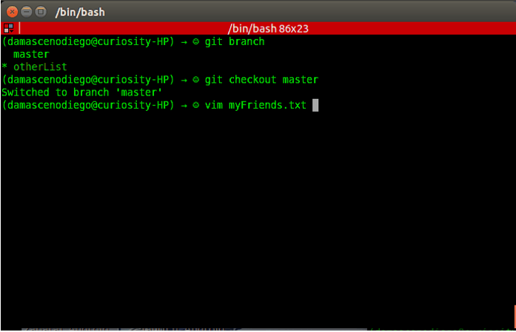
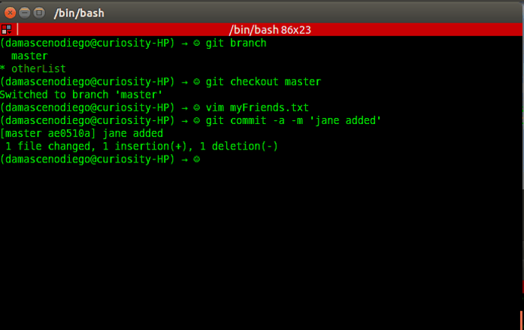
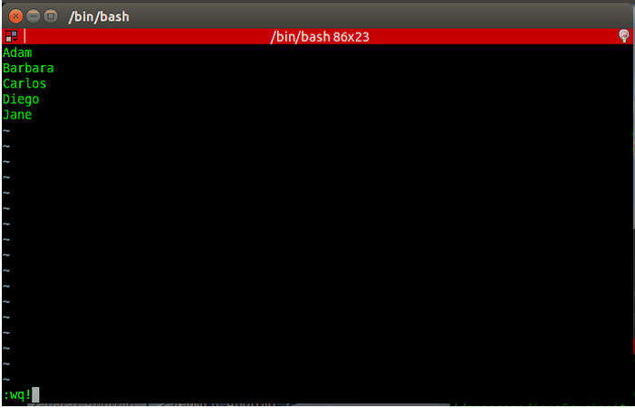
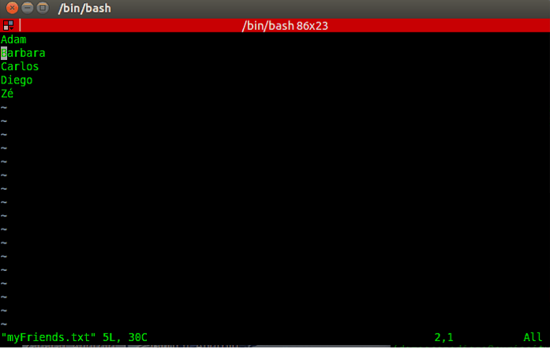
Crash Course (Getting Started)
git checkout master
Replace the last name by a different one git commit –a –m ‘jane added’

Slide 51
Crash Course (Getting Started)
git commit -a -m <message>
git chechout master

Slide 52
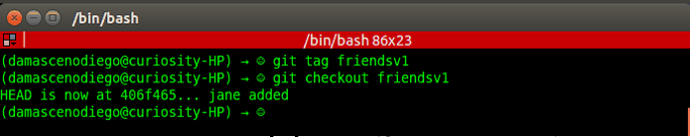
Crash Course (Getting Started)
git tag <tag name>
git checkout <tag name>
git tag
Create, list, delete or verify tag references.
friendsv1
git checkout <hash/branch name/tag name>
Notes:
Sentido lógico (tag)

Slide 53
Crash Course (Getting Started)
git tag <tag name>

Slide 54
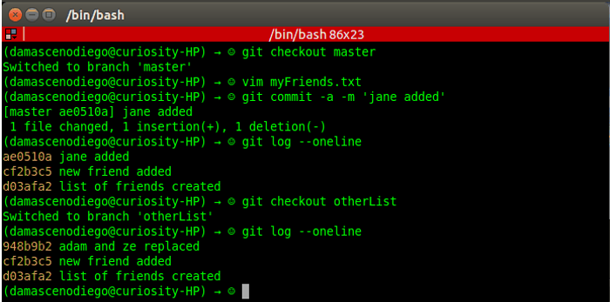
Crash Course (Getting Started)
Check log on both branches
(master and otherList)
using
git log --oneline
master
otherList

Slide 55
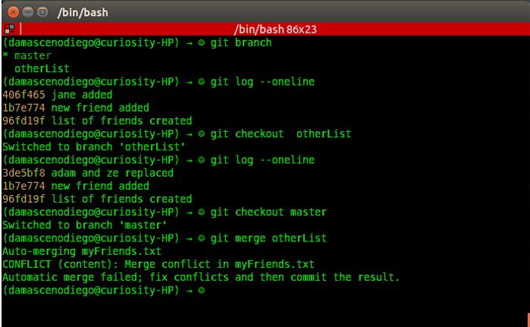
Crash Course (Getting Started)
git merge <branch to be merged with the current>
git merge
Join development histories together.
Attention to conflicting modifications!!!
master
otherList
git merge
otherList

Slide 56

Crash Course (Getting Started)
No conflict! ☺
HEAD
(master branch)
Common ancestor
otherList branch

Slide 57


Crash Course (Getting Started)
(After fixing conflict)
git add ./myFriends.txt
git commit

Slide 58
Crash Course (Getting Started)
git merge <branch name>
git commit -a -m <message>

Slide 59

Crash Course (Getting Started)
git log --oneline --graph

Slide 60

Crash Course (Getting Started)

Slide 61

Crash Course (Getting Started)

Slide 62
Crash Course on GIT
GitHub 101

Slide 63



Crash Course (GitHub 101)
Github
Social coding
Open source
9.3M people collaborating
21.9M repositories
https://github.com
D3: JavaScript virtualization library for SVG and HTML
Ruby on Rails: Popular Web framework based on Ruby

Slide 64

Crash Course (GitHub 101) – Create Account
← Username
← Email
Password
Click here!
https://github.com

Slide 65

Crash Course (GitHub 101) – Create Account

Slide 66

Crash Course (GitHub 101) – Create Repository

Slide 67

Crash Course (GitHub 101) – Create Repository

Slide 68

Crash Course (GitHub 101) – Create Repository
git remote add <repository name> <url>
git push -u <repository name> <branch name>
git remote
Manage the set of repositories ("remotes") whose branches you track.
git push
Updates remote refs using local refs, while sending objects necessary to complete the given refs.
https://github.com/damascenodiego/myFriendsSample.git
origin
master

Slide 69

Crash Course (GitHub 101) – Create Repository

Slide 70

Crash Course (GitHub 101) – Clone a Remote Repository
git clone <url> <target directory>
git clone
Clone a repository into a new directory.
http://github.com/damascenodiego/myFriendsSample

Slide 71




Crash Course (GitHub 101) – Push to a Remote Repository
(Sort names on myFriends.txt)
git commit –a –m ‘sorted’
git push –u <repository name> <branch name>
origin
master

Slide 72
Crash Course (GitHub 101) – Pull and Fetch from a Remote Repository
What if a local repository is not up to date?

Slide 73

Crash Course (GitHub 101) – Pull from a Remote Repository
git pull <remote name>
git pull
Fetch from and integrate with a local branch.
origin

Slide 74

Crash Course (GitHub 101) – Fetch from a Remote Repository
git fetch <remote name>
git fetch
Fetches named heads or tags from one or more other repositories, along with the objects necessary to complete them.
origin

Slide 75



Crash Course (GitHub 101) – Fork Repository

Slide 76

Crash Course (GitHub 101) – Fork Repository

Slide 77

Crash Course (GitHub 101) – Fork Repository

Slide 78

Crash Course (GitHub 101) – Delete a Remote Repository

Slide 79


Crash Course (GitHub 101) – Delete a Remote Repository

Slide 80

Crash Course (GitHub 101) – Delete a Remote Repository

Slide 81
Crash Course (GitHub 101) – Other features
Readme.md
Wiki page
Web diff (code/image)
Pull Request
Comment & Discuss
Issue Tracking

Slide 82

Crash Course (GitHub 101) – Readme.md

Slide 83

Crash Course (GitHub 101) – Wiki Page

Slide 84

Crash Course (GitHub 101) – Web Diff (Code)

Slide 85

Crash Course (GitHub 101) – Web Diff (Image)

Slide 86

Crash Course (GitHub 101) – Pull Request
How can I have commits accepted in another project?

Slide 87


Crash Course (GitHub 101) – Pull Request

Slide 88

Crash Course (GitHub 101) – Comment & Discuss

Slide 89

Crash Course (GitHub 101) – Issue Tracking

Slide 90
Crash Course on GIT
Eclipse Git (EGit)

Slide 91


Crash Course (Eclipse Git)
Eclipse Git (EGit)
Eclipse plug-in
Allows you to use Git directly within Eclipse IDE
Perspective and Views
Based on the JGit library.
Java library implementing Git functionalities

Slide 92

Crash Course (Eclipse Git) - Exercise
Fork the repository donationGame on GitHub → https://github.com/damascenodiego/donationGame
Clone your fork using Eclipse Git
Create a branch competitors_<nusp> from master branch
Put your competitors in a package named br.usp.icmc.ssc01032015.competitors.id<nusp>
Adapt your classes according to the project specification (extends AbstractCompetitor)
Create a Tournament.java in a package named br.usp.icmc.ssc01032015.tournament.id<nusp>
Make it run your classes. You can use as reference the class Tournament0000000.java
Commit and Push
Create a Pull Request

Slide 93


Slide 94

Crash Course (Eclipse Git)

Slide 95

Crash Course (Eclipse Git)

Slide 96


Slide 97


Slide 98

Crash Course (Eclipse Git)

Slide 99

Crash Course (Eclipse Git)

Slide 100

Crash Course (Eclipse Git)
GitHub Repository
GitHub User/Password

Slide 101

Crash Course (Eclipse Git)

Slide 102

Crash Course (Eclipse Git)
Local Repository (Clone)

Slide 103

Crash Course (Eclipse Git)

Slide 104

Crash Course (Eclipse Git)

Slide 105

Crash Course (Eclipse Git)

Slide 106

Crash Course (Eclipse Git)

Slide 107

Crash Course (Eclipse Git)

Slide 108

Crash Course (Eclipse Git)

Slide 109

Crash Course (Eclipse Git)
Competitors
Tournament

Slide 110

Crash Course (Eclipse Git)

Slide 111

Crash Course (Eclipse Git)

Slide 112

Crash Course (Eclipse Git)
Fork Commits

Slide 113


Slide 114


Slide 115


Slide 116







Slide 117
References++
Documentation
git help
EGIT- DOCUMENTATION: eclipse.org > Egit > Documentation
Books
Eric Sink. 2011. Version Control by Example (1st ed.). PYOW Sports Marketing. (FREE EBOOK)
Scott Chacon and Ben Straub. 2014. Pro Git (2nd ed.). Apress, Berkely, CA, USA. (FREE EBOOK)
Pressman, R. S. Software engineering: A practitioner’s approach. 5th ed. McGraw-Hill Higher Education, 2001.
Kemper C., Oxley, I. 2012. Foundation Version Control for Web Developers. Appress.
Videos/Courses
Learn Git in 20 Minutes: https://www.youtube.com/watch?v=Y9XZQO1n_7c
The Basics of Git and GitHub: https://www.youtube.com/watch?v=U8GBXvdmHT4
How to Use Git and GitHub: https://www.udacity.com/course/how-to-use-git-and-github--ud775
Web pages
https://confluence.atlassian.com/display/BITBUCKET/Bitbucket+101
https://sourceforge.net/p/forge/documentation/Git/
https://training.github.com/
https://www.atlassian.com/git/tutorials/
http://www.vogella.com/tutorials/EclipseGit/article.html

Slide 118

THANK YOU!

Slide 119
Crash Course on GIT
Carlos Diego N Damasceno - https://github.com/damascenodiego/

